Slide 1
Fruit Image Classification
By: Alistair Clarke

Slide 2
Problem Summary
The objective of this problem was to:
Classify different classes of fruit from images of fruit
Generate good image features
Explore the concept of data augmentation
Uncover which model architecture had the best performance

Slide 3
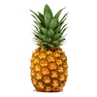
Problem Example
Probability Distribution:
Apple Probability of 0.20 (20%)
Mango Probability of 0.40 (40%)
Pineapple Probability of 0.98 (98%)
Is the image an apple?
Is the image a mango?
Is the image a pineapple?

Slide 4

The Dataset
Dataset Sources
Dataset Structures

Slide 5
Dataset Sources
Kaggle’s Fruit 360 Dataset
Google Formulated Dataset (used google images)

Slide 6
Dataset Structures
Kaggle’s Fruit 360 Dataset
Total number of images: 51,695.
Training set size: 38,695 images (one fruit per image).
Test set size: 13000 images (one fruit per image).
Actual training images used: 1577.
Number of classes: 77 (fruits)
Actual number of classes used: 6 (fruits).
Image size: 100x100 pixels
Image Background Color: white.
Google Formulated Dataset (used google images)
Total number of images: 300.
Training set size: 210 images (one fruit per image).
Test set size: 30 images (one fruit per image).
Validation set size: 60 images (one fruit per image).
Number of classes: 6 (fruits).
Image size: 100x100 pixels.
Image Background Color: white.

Slide 7
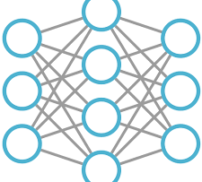
ML Approaches
Regular Dense Neural Network
Convolutional Neural Network
Pre-Trained Convolutional Neural Network

Slide 8
Regular Dense Neural Network Results
Parameters Used:
Epochs: 30
Batches: 5
Training Accuracy:
97%
Validation Accuracy:
80%

Slide 9
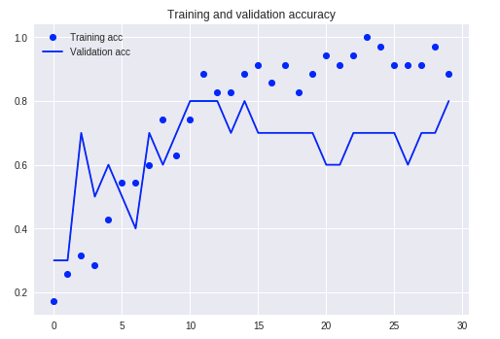
Regular Dense Neural Network Graphical Plot

Slide 10
Convolutional Neural Network Results
Parameters Used:
Epochs: 30
Batches: 5
Steps per epoch: 10
Validation steps: 15
Training Accuracy:
50%
Validation Accuracy:
64%

Slide 11
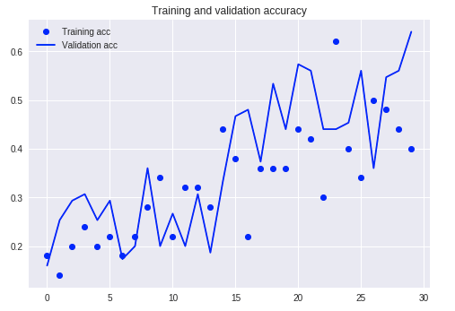
Convolutional Neural Network Graphical Plot

Slide 12
Pre-Trained Convolutional Neural Network Results
Parameters Used:
Epochs: 30
Batches: 5
Steps per epoch: 10
Validation steps: 15
Training Accuracy:
78%
Validation Accuracy:
85%
Test Accuracy:
66%

Slide 13
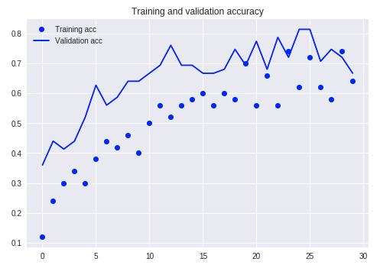
Pre-Trained Convolutional Neural Network Graphical Plot

Slide 14
Models Comparison Matrix (with Augmentation)
Architecture | Training Accuracy | Validation Accuracy | Test Accuracy
Regular Dense NN | 97% | 80% | N/A
Convolutional NN | 50% | 64% | N/A
Pre-Trained Conv NN | 78% | 85% | 66%

Slide 15
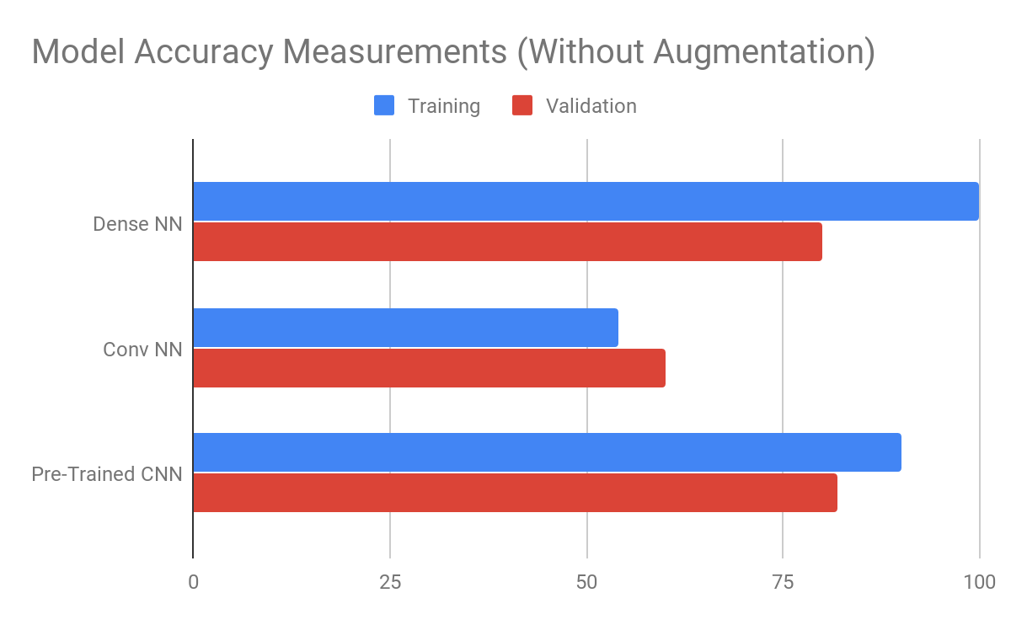
Models Comparison Graphical Plot

Slide 16
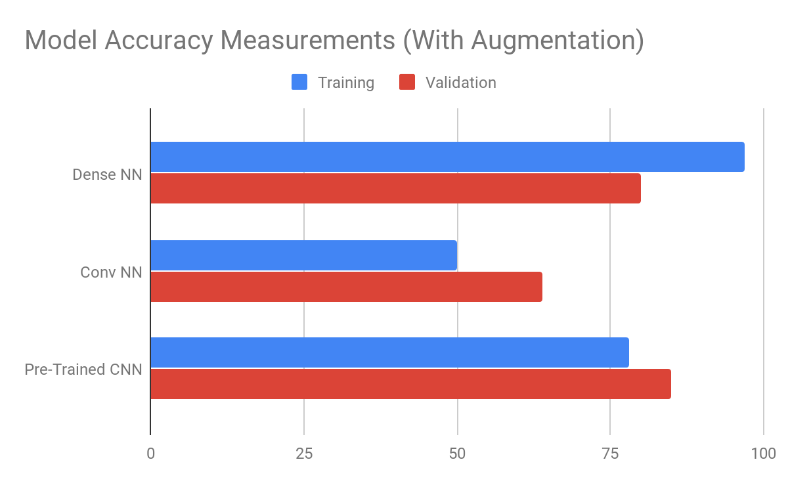
Models Comparison Graphical Plot

Slide 17
Future Work
If I had more time, I would have like to:
Experiment with K-Means Image Clusterization
Experiment with Different Regular Dense Neural Network, Convolutional Neural Network and Pre-Trained CNN Architectures
Collect more images to increase the Google Downloaded Dataset
Experiment with Localization

Slide 18
Thank you for your time
Are there any questions?

